Slide 1
Delegates And Events
.NET & JS Lab, RD belarus
Anzhelika Kravchuk

Slide 2
Module Overview
Declaring and Using Delegates
Using Lambda Expressions
Handling Events

Slide 3




Why Decouple an Operation from a Method?
Methods determined dynamically at run time
Method A or method B or method C
Callback methods
Enable you to specify a method (or methods) to run when an asynchronous method call completes, particularly when you use third-party assemblies
Multicast operations
Method A and method B and method C

Slide 4
Defining a Delegate
Callback functions are an extremely useful programming mechanism that has been around for years. The Microsoft .NET Framework exposes a callback function mechanism by using delegates. Unlike callback mechanisms used in other platforms, such as unmanaged C++, delegates offer much more functionality. For example, delegates ensure that the callback method is type-safe, in keeping with one of the most important goals of the common language runtime (CLR). Delegates also integrate the ability to call multiple methods sequentially and support the calling of static methods as well as instance methods.
A delegate is an object that knows how to call a method.
A delegate type defines the kind of method that delegate instances can call. Specifically, it defines the method’s return type and its parameter types. The following defines a delegate type called Transformer:

Slide 5
Defining a Delegate
Delegate type
public delegate int Transformer(int x);
Access modifier
Delegate function signature
Function signature must be same
public static int Square(int x) => return x * x;
Transformer transformer = new Transformer(Square);
Assigning a method to a delegate variable creates a delegete instance

Slide 6
Invoking a Delegate
Transformer transformer = Square;
The statement
is shorthand for
Transformer transformer = new Transformer (Square);
transformer(1);
Invoking Delegate
is shorthand for
transformer.Invoke(2);
if (transformer != null) transformer(1);
Invoking Delegate
transformer?.Invoke(2);

Slide 7
Delegates in Depth
public delegate int Transformer(int x);
Compiler C#
public class Transformer: MulticastDelegate
{
public Transformer(Object object, IntPtr method);
public virtual Int32 Invoke(Int32 x);
public virtual IAsyncResult BeginInvoke(Int32 x, AsyncCallback callback, Object object);
public virtual void EndInvoke(IAsyncResult result);
}

Slide 8
Delegates in Depth
Compiler C#

Slide 9
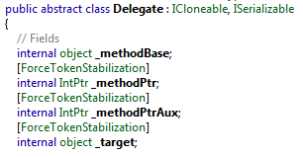
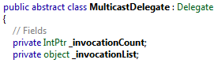
Delegates in Depth
System.Object
System.Delegate
System.MultiCastDelegate
delegate<T>

Slide 10
Delegates in Depth
The System.MulticastDelegate class is derived from System.Delegate, which is itself derived from System.Object. The reason why there are two delegate classes is historical and unfortunate; there should be just one delegate class in the FCL. Sadly, you need to be aware of both of these classes because even though all delegate types you create have MulticastDelegate as a base class, you’ll occasionally manipulate your delegate types by using methods de ned by the Delegate class instead of the MulticastDelegate class. For example, the Delegate class has static methods called Combine And Remove. The signatures for both of these methods indicate that they take Delegate parameters. Because your delegate type is derived from MulticastDelegate, which is derived from Delegate, instances of your delegate type can be passed to these methods.

Slide 11
Delegates in Depth
public abstract class Delegate : ICloneable, ISerializable
{
// Methods for interacting with a list of functions.
public static Delegate Combine(params Delegate[] delegates);
public static Delegate Combine(Delegate a, Delegate b);
public static Delegate Remove(Delegate source, Delegate value);
public static Delegate RemoveAll(Delegate source, Delegate value);
// Overloaded operations.
public static bool operator ==(Delegate dl, Delegate d2);
public static bool operator !=(Delegate dl, Delegate d2);
// Properties showing delegate purpose.
public MethodInfo Method { get; }
public object Target { get; }
}

Slide 12
Delegates in Depth
public abstract class MulticastDelegate : Delegate
{
// Returns a list of methods that the delegate “points to”.
public sealed override Delegate[] GetInvocationList ();
// Overloaded operations
public static bool operator ==(MulticastDelegate dl, MulticastDelegate d2);
public static bool operator != (MulticastDelegate dl, MulticastDelegate d2);
// Used internally to manage a list of methods,
// supported by the delegate
private IntPtr _invocationCount;
private object _invocationList;
}

Slide 13
Delegates in Depth
public delegate void Feedback(int value);
. . .
DelegateIntro di = new …;
. . .
Feedback fb1 = new Feedback(FeedbackToConsole);
Feedback fb2 = new Feedback(FeedbackToMsgBox);
Feedback fb3 = new Feedback(di.FeedbackToFile);
_target null
_methodPtr FeedbackToConsole
_invocationList null
fb1
_target null
_methodPtr FeedbackToMsgBox
_invocationList null
fb2
_target
_methodPtr FeedbackToFile
_invocationList null
(DelegateIntro Object)
fb3

Slide 14
Delegates in Depth
fbChain = null;
fbCain
null
_target null
_methodPtr FeedbackToConsole
_invocationList null
fb1
_target null
_methodPtr FeedbackToMsgBox
_invocationList null
fb2
_target
_methodPtr FeedbackToFile
_invocationList null
(DelegateIntro Object)
fb3

Slide 15
Delegates in Depth
fbChain = (Feedback)Delegate.Combine(fbChain, fb1);
fbCain
_target null
_methodPtr FeedbackToConsole
_invocationList null
fb1
_target null
_methodPtr FeedbackToMsgBox
_invocationList null
fb2
_target
_methodPtr FeedbackToFile
_invocationList null
(DelegateIntro Object)
fb3

Slide 16
Delegates in Depth
fbChain = (Feedback)Delegate.Combine(fbChain, fb2);
[0]
[1]
_target *************
_methodPtr *************
_invocationList
fbCain
_target null
_methodPtr FeedbackToConsole
_invocationList null
fb1
_target null
_methodPtr FeedbackToMsgBox
_invocationList null
fb2
_target
_methodPtr FeedbackToFile
_invocationList null
(DelegateIntro Object)
fb3

Slide 17
Delegates in Depth
fbChain = (Feedback)Delegate.Combine(fbChain, fb3);
_target *************
_methodPtr *************
_invocationList
[0]
[1]
fbCain
[0]
[1]
[2]
_target *************
_methodPtr *************
_invocationList
_target null
_methodPtr FeedbackToConsole
_invocationList null
fb1
_target null
_methodPtr FeedbackToMsgBox
_invocationList null
fb2
_target
_methodPtr FeedbackToFile
_invocationList null
(DelegateIntro Object)
fb3

Slide 18
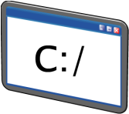



Multicast Delegates
int value = . . .;
. . .
if (fbChain != null) fbChain (value);
FeedbackToConsole
FeedbackToMsgBox
FeedbackToFile

Slide 19
Multicast Delegates
fbChain = (Feedback)Delegate.Remove(fbChain, new Feedback(FeedbackToMsgBox));
. . .
fbChain (value);
FeedbackToConsole
FeedbackToMsgBox
FeedbackToFile

Slide 20
Multicast Delegates
DelegateIntro di;
. . .
Feedback fb1 = FeedbackToConsole;
Feedback fb2 = FeedbackToMsgBox;
Feedback fb3 = di.FeedbackToFile;
. . .
Feedback fbChain = null;
fbChain += fb1;
fbChain += fb2;
fbChain += fb3;
. . .
fbChain -= FeedbackToMsgBox;
shorthand sintax
Delegates are immutable, so when you call += or -=, you’re in fact creating a new delegate instance and assigning it to the existing variable

Slide 21
Multicast Delegates
Expression | Result
null + d1 | d1
d1 + null | d1
d1 + d2 | [d1, d2]
d1 + [d2, d3] | [d1, d2, d3]
[d1, d2] + [d2, d3] | [d1, d2, d2, d3]
[d1, d2] – d2 | d1
[d1, d2] – d1 | d2
[d1, d2, d1] – d1 | [d1, d2]
[d1, d2, d3] – [d1, d2] | d3
[d1, d2, d3] – [d2, d1] | [d1, d2, d3]
[d1, d2, d3, d1, d2] – [d1, d2] | [d1, d2, d3]
[d1, d2] – [d1, d2] | null

Slide 22
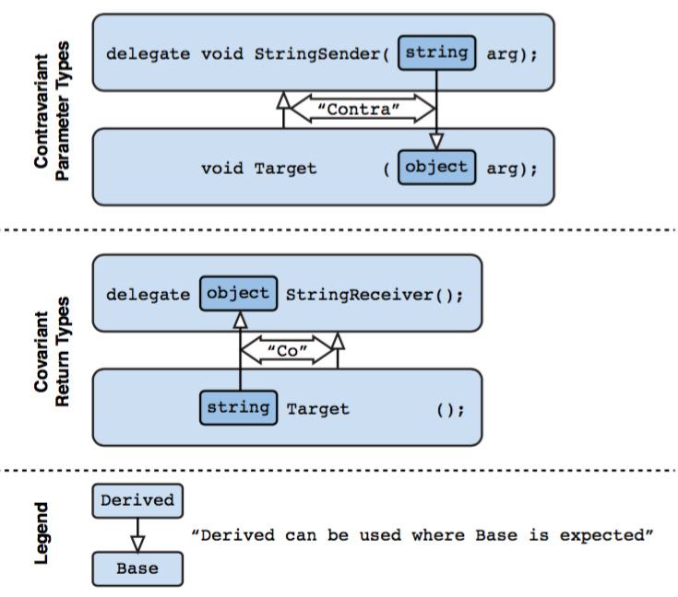
Covariant and contravariant of delegates

Slide 23
Anonymous methods
Add the anonymous method as a handler for a delegate
Use the overloaded delegate keyword
Optionally specify the parameter names and types for the anonymous method
SomeDelegate del += new SomeDelegate (delegate (int parameter)
{
// Perform operation.
return 10;
});
Add the method body for the anonymous method
Do not specify a return type; the compiler will work out the return type based on the context

Slide 24
Anonymous methods
delegate void DelegateType();
. . .
DelegateType delegateInstance = delegate() { Console.WriteLine("Hello"); };
delegateInstance += delegate() { Console.WriteLine("Bonjour"); };
delegateInstance();
Hello
Bonjour
CTE
delegate void DelegateType(params int[] arr);
. . .
return delegate(params int[] arr){ Console.WriteLine("Hello");};

Slide 25
Lambda Expression
A lambda expression is an expression that returns a method
Lambda expressions are defined by using the => operator
Lambda expressions use a natural and concise syntax
Lambda operator
x => x * x
This code example can be read as: Given x, calculate x * x
Parameter
Body expression
(parameters) => expression-or-statement-block

Slide 26
Lambda Expression
Start with anonimus method
delegate(string text) { return text.Length; }
Convert to lambda expression
(string text) => { return text.Length; }
Single expression, no braces required
(string text) => return text.Length
Let the compiler unfer the parameter type
(text) => text.Length
Remove unnecessary paranthees
text => text.Length

Slide 27
Lambda Expression
Lambda Expression with Multiple parameters
(s, youngAge) => s.Age >= youngage;
(Student s,int youngAge) => s.Age >= youngage;
Lambda expression without any parameter:
() => Console.WriteLine("Parameter less lambda expression")
Multiple statements in body expression
(s, youngAge) =>
{
Console.WriteLine("Lambda expression with multiple statements in the body");
Return s.Age >= youngAge;
}

Slide 28
Variable Scope in Lambda Expressions
Lambda expressions can use any variables that are in scope when they are declared
Lambda expressions can define variables
string name; // Class level field.
...
void SomeMethod() {
int count = 0;
del += new SomeDelegate(() => {
int temp = 10;
CheckName(name);
count++; // Do something more interesting.
});
}
Using an outer variable in a lambda expression can extend its life cycle
Use this feature carefully!

Slide 29
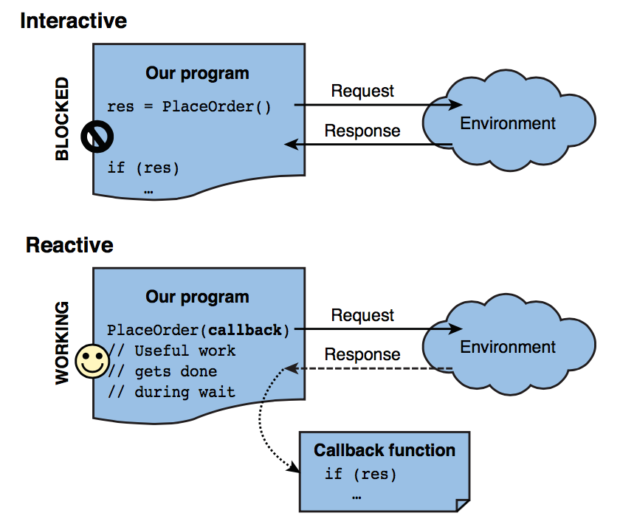
Interactive versus reactive programming
Notes:
In interactive programming, you actively send out requests for information to some environment surrounding you. This could be as simple as calling some method or as complex as sending a request to a web service on the other side of the globe. The essential part is you’re in the driver seat and make a request, and then wait for the response to come back.
. In reactive programming, the environment calls you at some point in time with information for you to react to. Examples include the user clicking some user inter- face element such as a button, over events raised by the local system (for example, signaling the hard disk is almost full), or data coming in over the network. Now the environment is in control, and your application needs to react when asked to do so.

Slide 30
The Two Sides of Delegates
Invoking a delegate is an interactive act
Event handling
is a very reactive business

Slide 31
Events
When using delegates, two emergent roles commonly appear: broadcaster (publisher) and listener (subscriber).
The broadcaster is a type that contains a delegate field. The broadcaster decides when to broadcast by invoking the delegate.
The subscribers are the method target recipients. A subscriber decides when to start and stop listening by calling += and -= on the broadcaster’s delegate. A subscriber does not know about, or interfere with, other subscribers.
Events are a language feature that formalizes this pattern. An event is a construct that exposes just the subset of delegate features required for the broadcaster/subscriber model. The main purpose of events is to prevent subscribers from interfering with one another.

Slide 32
Events
Subscriber 1
Publisher
Subscribe Event
Subscribe: Event += Event_Handler
Delegete
Event Handler
Event
Raise Event
Event handler signature must match with event delegate signature
Raise Event
Subscribe Event
Subscriber 2
Subscribe: Event += Event_Handler
Event Handler

Slide 33
Events
Delegate declaration
public delegate void PriceChangedHandler (decimal oldPrice, decimal newPrice);
public class Broadcaster
{
public event PriceChangedHandler PriceChanged;
}
Event declaration
The easiest way to declare an event is to put the event keyword in front of a delegate member

Slide 34
Events in depth
public delegate void PriceChangedHandler (decimal oldPrice, decimal newPrice);
public class Broadcaster
{
public event PriceChangedHandler PriceChanged;
}
Compiler C#
PriceChangedHandler priceChanged;
PriceChangedHandler PriceChanged {
add
{
priceChanged += value;
}
remove
{
priceChanged -= value;
}
}
A private delegate field
A public pair of event accessor functions
(add_PriceChanged and remove_Pri ceChanged),
whose implementations forward the += and -=
operations to the private delegate field

Slide 35
Events in depth
public delegate void PriceChangedHandler (decimal oldPrice, decimal newPrice);
public class Broadcaster
{
public event PriceChangedHandler PriceChanged;
}
Compiler C#
The event accessors
The private delegate field

Slide 36
Standard Event Pattern. First Step
EventArgs is a base class for conveying information for an event
EventArgs subclass is named according to the information it contains (rather than the event for which it will be used)
public class PriceChangedEventArgs : System.EventArgs
{
public readonly decimal LastPrice;
public readonly decimal NewPrice;
public PriceChangedEventArgs (decimal lastPrice, decimal newPrice)
{
LastPrice = lastPrice;
NewPrice = newPrice;
}
}
It typically exposes data as properties or as read-only fields

Slide 37
Standard Event Pattern. Second Step
There are three rules to define a delegate for the event:
It must have a void return type.
It must accept two arguments: the first of type object, and the second a subclass of EventArgs. The first argument indicates the event broadcaster, and the second argument contains the extra information to convey.
Its name must end with EventHandler.
public delegate void EventHandler<TEventArgs> (object source, TEventArgs e) where TEventArgs : EventArgs;
public event EventHandler<PriceChangedEventArgs> PriceChanged;
The generic EventHandler delegate has been used here

Slide 38
Standard Event Pattern. Last Step
The name must match the name of the event, prefixed with the word On, and then accept a single EventArgs argument
public class Stock
{
...
public event EventHandler<PriceChangedEventArgs> PriceChanged;
protected virtual void OnPriceChanged (PriceChangedEventArgs e)
{
if (PriceChanged != null) PriceChanged (this, e);
}
}
The pattern requires that you write a protected virtual method that raise the event
var temp = PriceChanged; if (temp != null) temp (this, e);
In multithreaded scenarios
PriceChanged?.Invoke (this, e);
C# 6.0 – now the best general
way to invoke events

Slide 39
Event Modifiers
Events can be static
public class Foo
{
public static event EventHandler<EventArgs> StaticEvent;
public virtual event EventHandler<EventArgs> VirtualEvent;
}
Like methods, events can be virtual, overridden, abstract, or sealed

Slide 40
Best Practices for Using Events
Use the standard event signature
Use a protected virtual method to raise an event
Do not pass null to an event
Notes:
Explain the best practice for using events:
Use the standard event signature:
Highlight how using a standard signature makes using events easier for all developers.
Remind students of the standard event signature: void name (object sender, EventArgs e).
Use a protected virtual method to raise an event:
Explain the benefits of using a protected virtual method—it can be overridden in child classes if necessary.
Explain the standard for using the word On before the event name for methods that raise events.
Explain that the On method signature should match the signature of the event.
Explain that using a method to raise an event can reduce code duplication—use the standard check for null as an example.
Do not pass null to an event:
Explain that students should avoid passing null as a parameter when they raise an event. In particular, they should always pass the this keyword as the first parameter.

